Slide 1

New York COVID- 19 Statistics
Group 2
Notes:
ashlee

Slide 2




Meet The Team
Alicia J.
Ashlee T.
Kate S.
Olivia G.
coding screen sharing, coding driver
presentation formatting,
coding navigating
coding navigating, researching
presentation screen sharing, code commenter
Notes:
Hey y’all, this is ChiChi (I got kicked out 😩). I just want to say you all did an amazing job this unit and should be very proud of yourselves! Good luck on your presentation!!
Hey ChiChi (if you’re still here)! Thanks so much for your help this week!!
– Kate

Slide 3
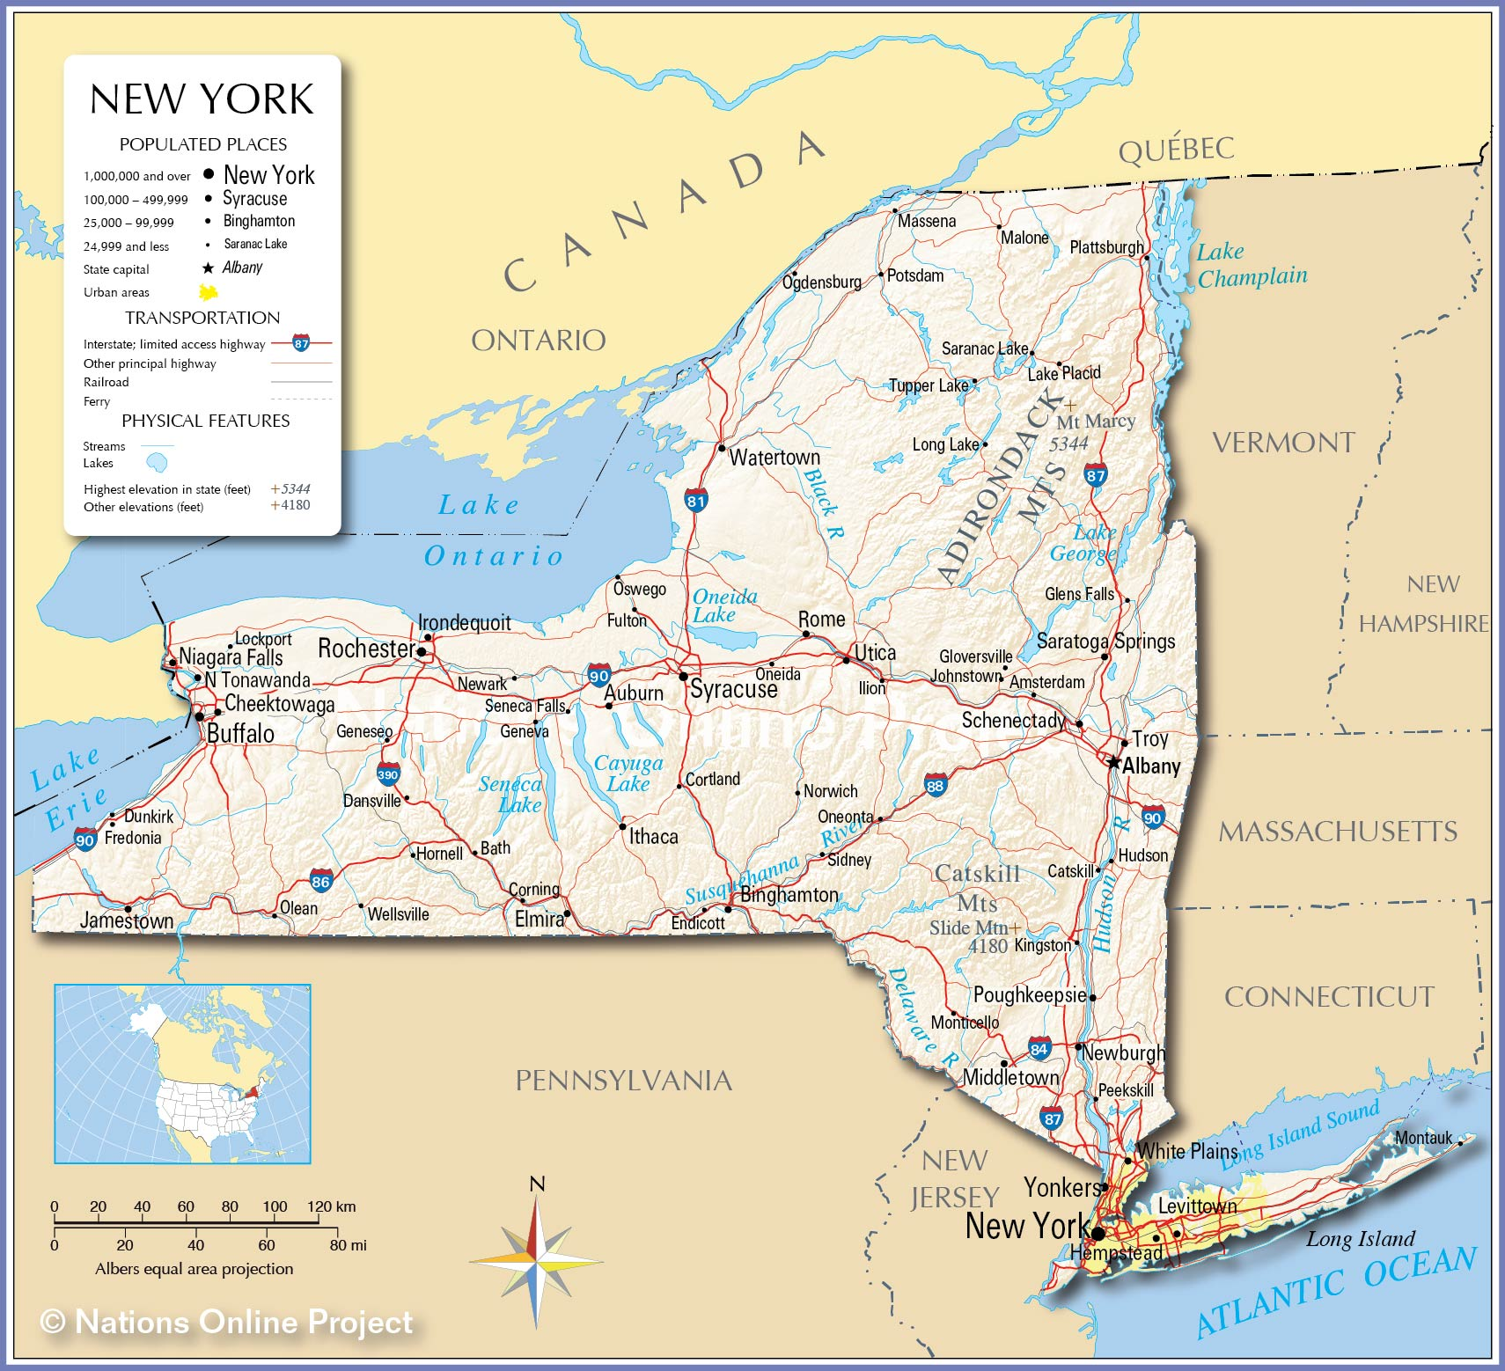
Introduction to New York
Brief History
Native Americans came to NY around 5,000 years ago.
In 1624, Dutch settlers established New Amsterdam on present-day Manhattan.
It was renamed New York once the British took control of the area in 1664.
After the American Revolution in 1776, New York became a U.S. colony, then a state in 1788.
Population
NY is the fourth most populous state in the US.
NYC is the most populous city in the US.
Politics
On August 10, Governor Cuomo announced his resignation.
He will be replaced by lieutenant governor, Kathy Hochul.
Notes:
Kate
Although all of us are probably very familiar with New York, we wanted to give a brief overview on the history, population, and recent political developments of the state.
Native Americans came to NY around 5,000 years ago.
In 1624, Dutch settlers established New Amsterdam on present-day Manhattan.
New Amsterdam was renamed New York once the British took control of the area in 1664.
After the American Revolution in 1776, New York became a U.S. colony, then a state soon after.
NY’s population of over 20 million people (as of 2020) makes it the fourth most populous state in the US.
NYC is the most populous city in the United States, with around 8.5 million residents.
On August 10, Governor Andrew Cuomo declared he will resign effective in two weeks because of a sexual harassment scandal that has crippled his administration.
He will be replaced by lieutenant governor and fellow democrat, Kathy Hochul.

Slide 4
Demographics of New York (Census April 1, 2020)
Age
5.8% Persons under 5 years
20.7% Persons under 18 years
16.9% Persons 65 years and over
Race
69.6% White
19.3% Hispanic or Latino
17.6% Black or African American
9.0% Asian
2.7% Two or More Races
1.0% American Indian and Alaska Native
0.1% Native Hawaiian and Pacific Islander
Notes:
ashlee

Slide 5
New York COVID-19 Regulations
Mar 7, 2020 Governor Cuomo declares a state of emergency
Mar 16, 2020 NYC public schools close
Mar 17, 2020 NYC bars and restaurants close, except for delivery
Mar 22, 2020 Non-essential workers ordered to stay home
Mar 28, 2020 Governor Cuomo halts all nonessential construction sites
April 15, 2020 Governor Cuomo requires face masks or coverings in public places
May 1, 2020 Governor Cuomo closes all schools for the remainder of the academic year
Jun 8, 2020 NYC begins Phase 1 reopening
Nov 19, 2020 NYC schools switch to all-remote
Nov 21, 2020 Restrictions on indoor dining are renewed
Notes:
alicia

Slide 6
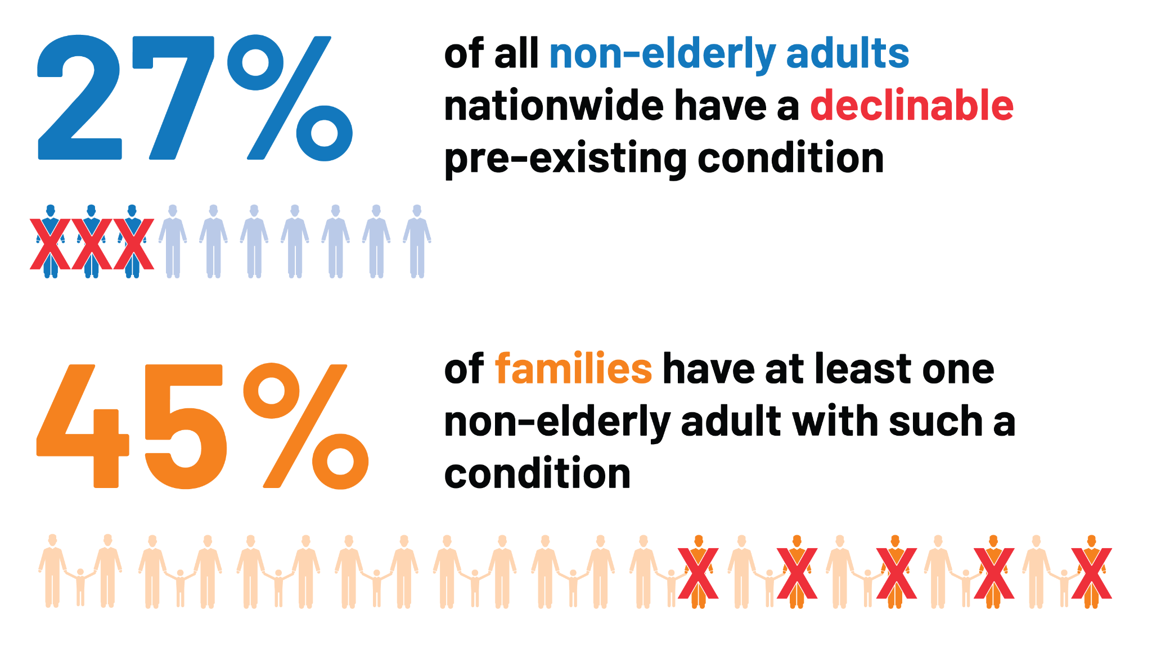
Numbers of people with pre-existing conditions
According to the list of comorbidities and underlying conditions New York State will use to determine eligibility for the COVID-19 vaccine those with
Cancer
Chronic Kidney Disease
Pulmonary Disease
Intellectual and Developmental Disabilities
Heart Condition
Immunocompromised State
Severe Obesity
Pregnancy
Sickle Cell Disease or Thalassemia
Notes:
alicia

Slide 7
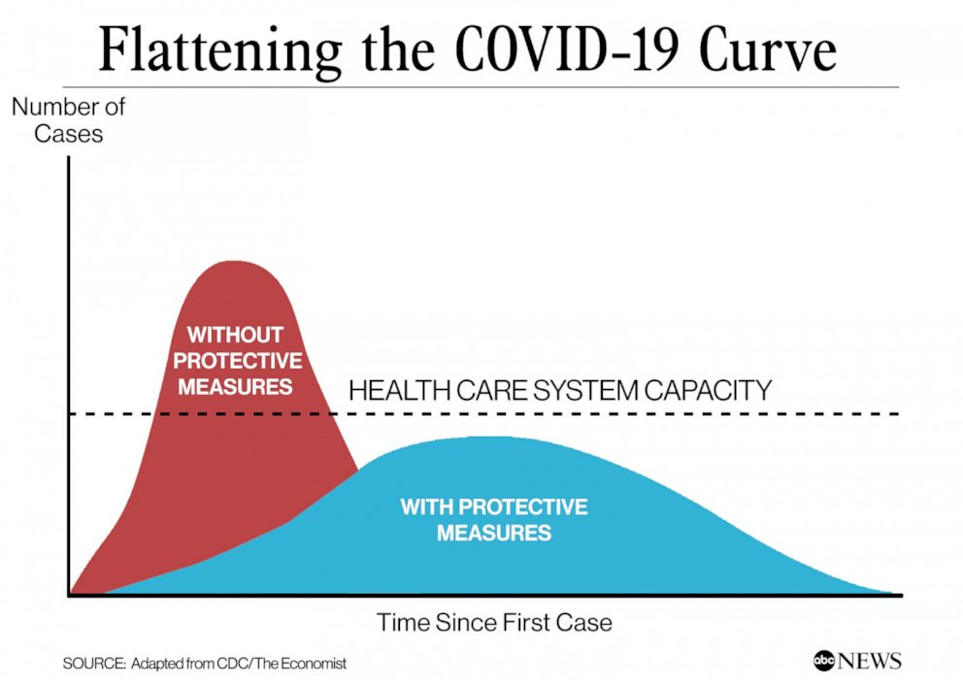
Flattening the Curve
Flattening the curve is a public health strategy to slow down the spread of the SARS-CoV-2 virus during the COVID-19 pandemic.
The curve being flattened is the epidemic curve, a visual representation of the number of infected people needing health care over time.
Notes:
Olivia

Slide 8
Impact of 2020 Reopening in NY on Pandemic Numbers
Summer 2020
NY began phased reopening in the summer of 2020.
The number of people infected with the coronavirus was still high.
Transmission quickly rekindled with increased contact.
Fall 2020
Gyms, malls, schools, restaurants, and bars began reopening in the fall of 2020.
NY reached half a million COVID cases as the US experienced a dramatic rise in transmission.
NY was forced to implement new restrictions as the world waited for a vaccine.
Notes:
Olivia
Summer 2020
As NY began phased reopening in the summer of 2020, people were eager to go out and resume some of their regular activities.
But the number of people infected with the coronavirus was still high, and transmission of the virus was rekindled once people increased their activities and contact with each other.
Fall 2020
As gyms, malls, schools, restaurants, and bars began reopening in the fall of 2020.
NY reached half a million COVID cases as the US experienced a dramatic rise in transmission.
Therefore, NY was forced to reinforce restrictions.

Slide 9
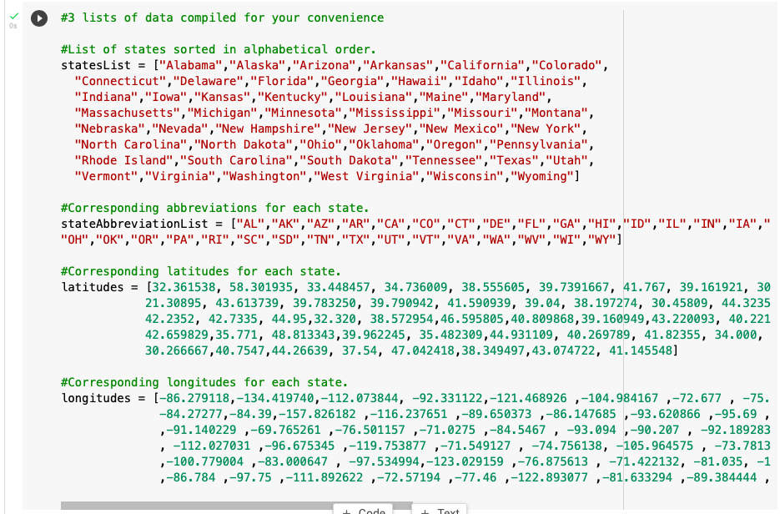
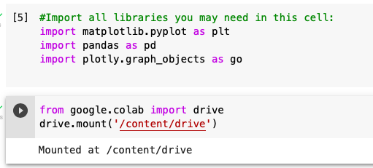
Before we Start
We imported needed libraries and ran given cells
Notes:
Oliva - we started our code by importing the libraries we would need. Pandas would allow us to read in our data, Matplotlib allows us to create visualizations of the data, and plotly creates more sophisticated visualizations. Next, we mounted our drives. A U.S. states list, state abbreviation list, latitude list, and longitude list were added to the code.

Slide 10
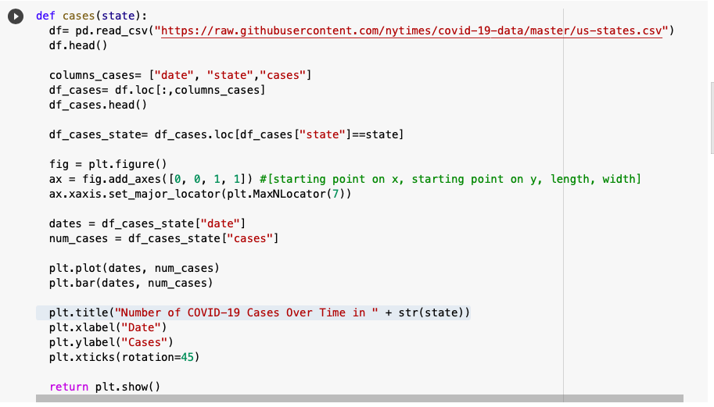
Chart 1: Cases Bar Graph Code
Notes:
Kate
This is the function we coded for the covid cases bar graph.
In line 1, we defined our function, cases, and added “state” as the parameter.
Secondly, we used pandas to read in the csv.
Next, we created a new dataframe containing only the date, state, and cases columns using .loc[].
Then we began creating the visual using matplotlib syntax.
The x-axis of our graph represents dates, while the y-axis represents cases.
Finally, we added a title, “Number of Covid-19 Cases Over Time in… specific state”, labels for each axis, and returned the function.

Slide 11
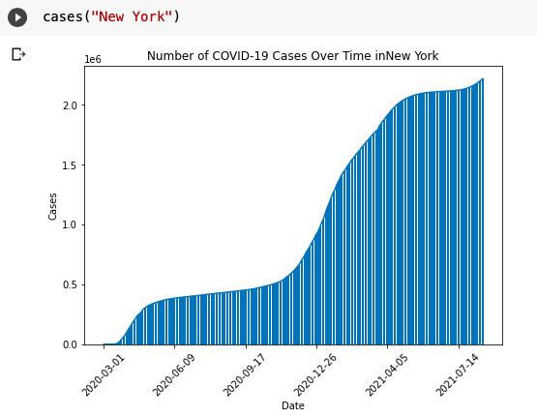
Chart 1: Cases Bar Graph Example
Notes:
Kate
Here is our bar graph for the number of COVID-19 cases over time in new york. As you can see, cases have been increasing since march 3, 2020, seemed to have flattened out during the summer of 2020, but dramatically spiked around December, 2020. Now, cases are continuing to increase, but at a much less extreme rate, thanks to the vaccine.

Slide 12
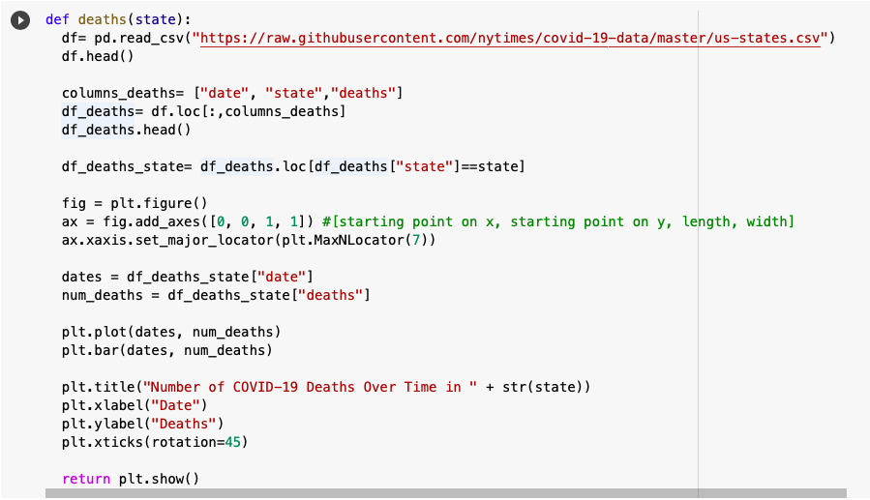
Chart 2: Deaths Bar Graph Code
Notes:
Olivia - We started by defining the function, deaths, and adding state as a parameter. We read in the csv file using the pd.read function. Next, we made a dataframe which contained date, state, and deaths columns. Using matplotlib, we created the visualization of our date. The x-axis of the graph represents dates, and the y-axis represents the number of covid-19 deaths. We titled the graph, “Number of COVID-19 Cases Over Time in ".

Slide 13
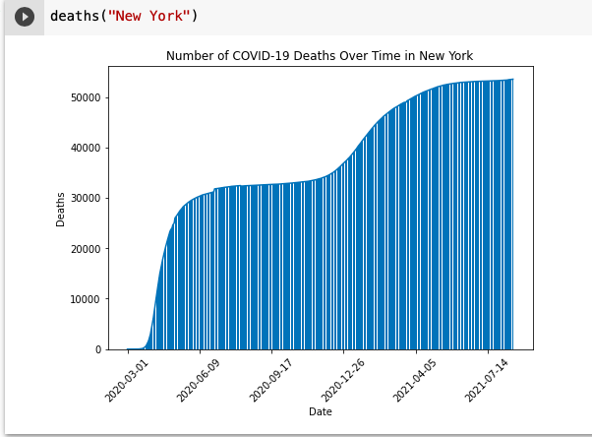
Chart 2: Deaths Bar Graph Example
Notes:
Olivia - This is the graph we created showing the number of covid-19 deaths on different dates from March 3rd 2020 to july 14th 2021. As shown in the graph, the number of deaths has been steadily increasing since March 3rd 2020.

Slide 14
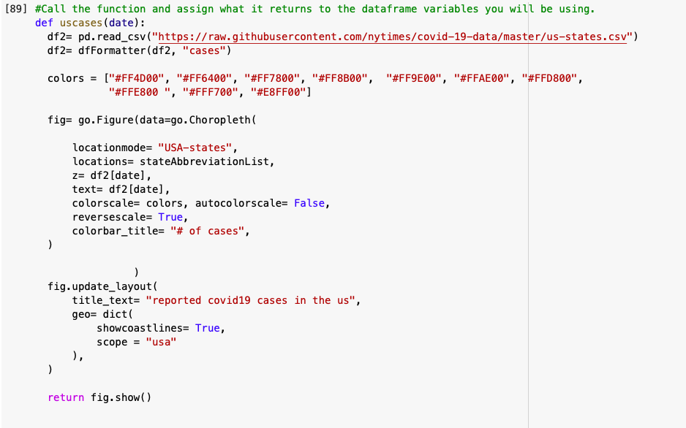
Chart 3: Cases Choropleth Map Code
Notes:
Kate
In line 1, we defined our function, uscases, and added “date” as the parameter.
Next, we used pandas to read in the csv and used the dfFormatter to create a new dataframe with only the cases column.
Then, we listed 10 hex codes for our colors, created the choropleth map using go.Figure and defined the locationmode, locations, colorscale, and color bar title.
Finally, we assigned the map the title, “reported covid-19 cases in the us” and narrowed scope of the map to the us, and returned the figure.

Slide 15
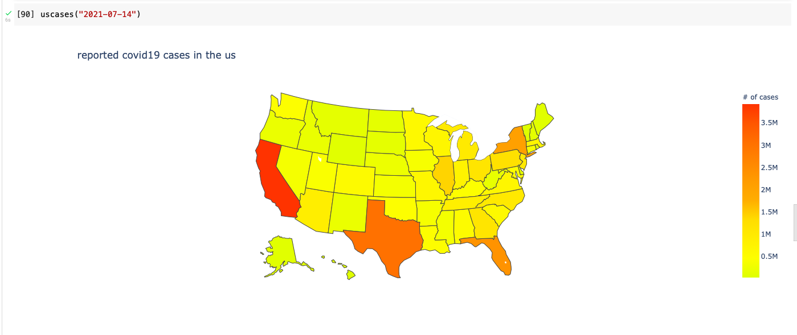
Chart 3: Cases Choropleth Map Example
Notes:
Kate
Here is our choropleth map for the number of reported COVID-19 cases in the us on July 14, 2021. As you can see by the red color, the number of cases was the highest in California, Texas, Florida, and New York at the time. These states reported the most cases due to their large populations.

Slide 16
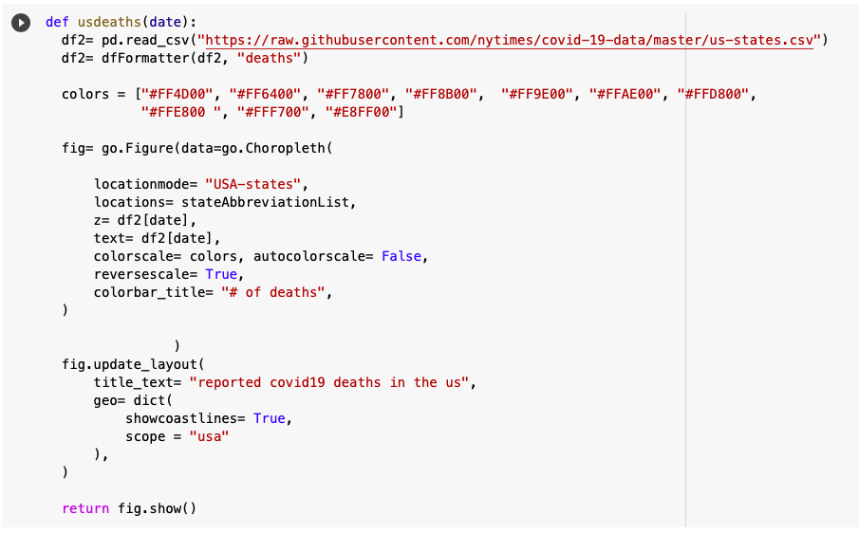
Chart 4: Deaths Choropleth Map Code
Notes:
alicia

Slide 17
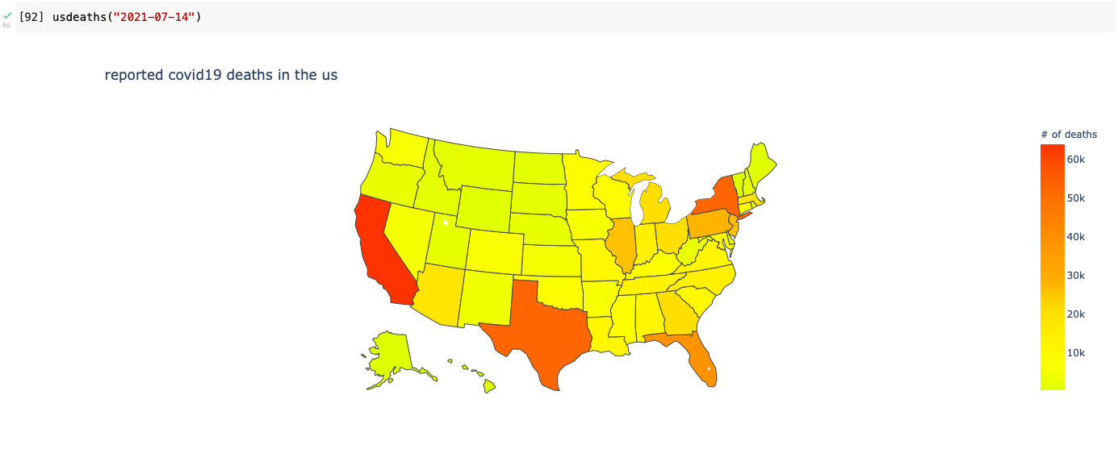
Chart 4: Deaths Choropleth Map Graph
Notes:
alicia

Slide 18
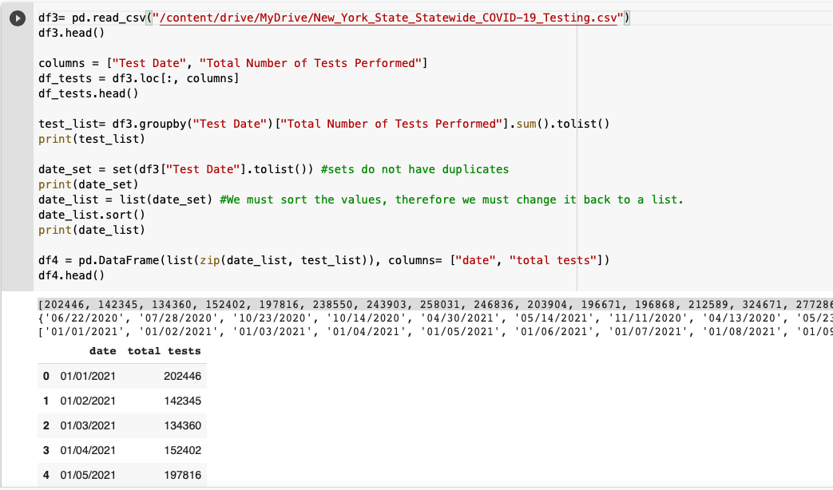
Chart 5: Tests Conducted in NY Code
Notes:
ashlee

Slide 19
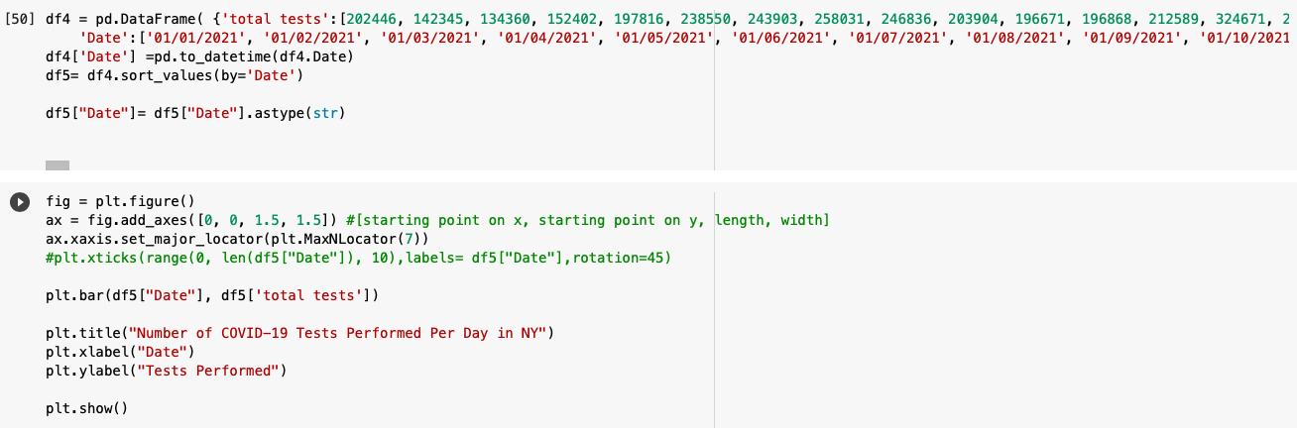
Chart 5: Tests Conducted in NY Code
Notes:
ashlee

Slide 20
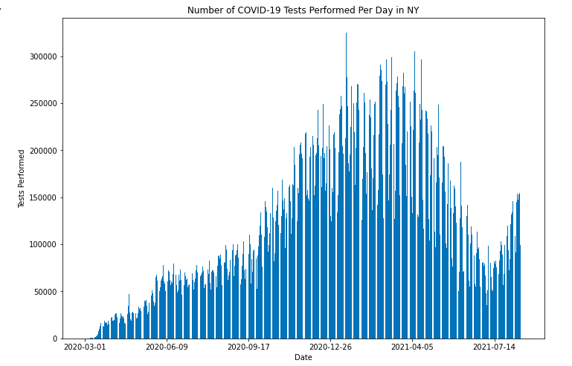
Chart 5: Tests Conducted in NY Graph
Notes:
alicia

Slide 21
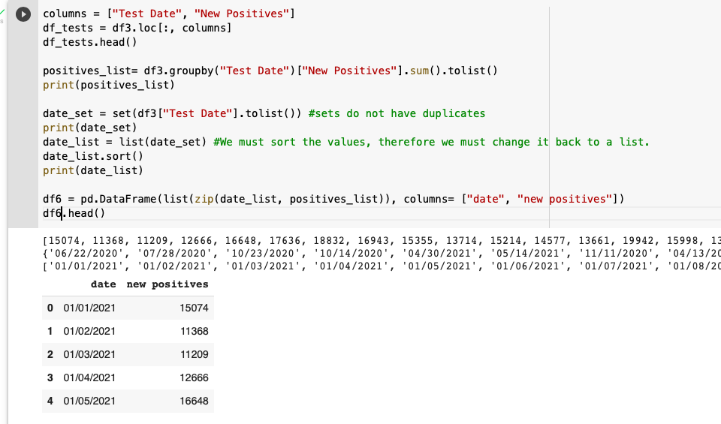
Chart 6: New Positives in NY Code
Notes:
ashlee

Slide 22
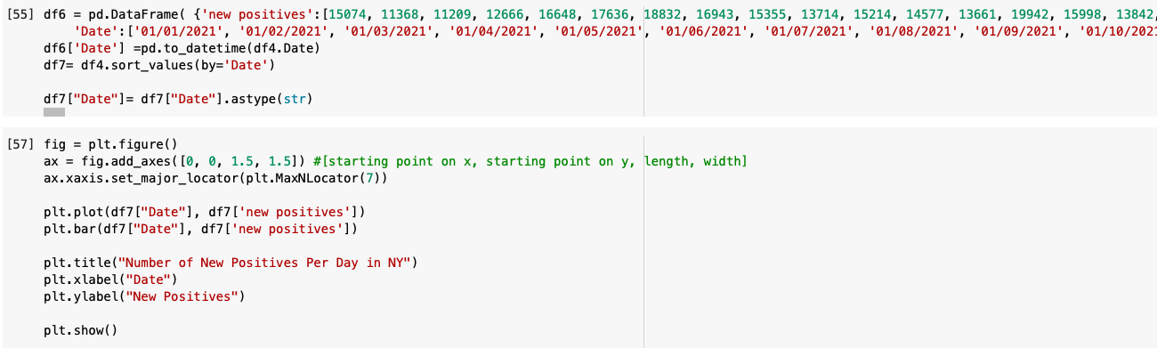
Chart 6: New Positives in NY Code
Notes:
ashlee

Slide 23
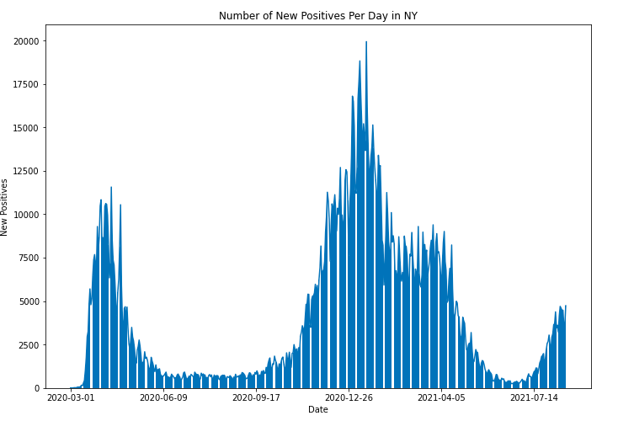
Chart 6: New Positives in NY Graph
Notes:
ashlee

Slide 24
Final Thoughts on NY’s Covid Strategy
Based off of the statistics and visualizations created, the NY’s Covid Strategy could’ve been improved.
As shown in the New Positives in US Graph, there were many positive cases of covid in December of 2020, only to decrease and increase again in July of 2021.
According to the deaths of Covid graph, there was a high number of 50-60 thousand.
Improvements of the strategy such as stricter mask mandates, earlier testing, compliance to the new regulations by the public, could’ve been implemented to better NY’s Covid Strategy.
Notes:
alicia

Slide 25
Coding Challenges
We had an issue getting the dates on the bar graph to show up clearly
First we had an issue of the overcrowding of tick marks, meaning that we were unable to show the dates properly
We asked a Junior TA and she provided us code to reduce the amount of ticks on our bar graphs
We then had an issue with the dates only showing the years and not the dates on the graph
For this, we also asked a Junior TA, Google, and Carol for assistance
Notes:
ashlee

Slide 26

Next Steps
Complete the bonus challenge.
Encourage eligible family, friends, and fellow New Yorkers to get vaccinated if they have not already.
Continue to follow CDC guidelines on COVID safety practices.
Encourage others to continue wearing masks and social distancing for the safety of the community.
Be aware of new developments, such as the Delta Variant and COVID booster shots.
Notes:
Olivia

Slide 27
Takeaways From the Brown Scholars Program
Gained a foundational understanding of computer science and the coding language, python.
Deepened our knowledge of earthquakes, climate change, astrophysics, molecular genetics, anthropology, and epidemiology.
Learned how to apply computer science to the real world.
Strengthened our communication, collaboration, and leadership, and problem-solving skills.
Notes:
Kate

Slide 28
Citations
www.census.gov/quickfacts/NY
www.investopedia.com/historical-timeline-of-covid-19-in-new-york-city-5071986
kids.nationalgeographic.com/geography/states/article/new-york
www.ny1.com/nyc/all-boroughs/news/2021/03/10/timeline--how-covid-19-changed-nyc
www.census.gov/quickfacts/fact/table/NY/POP010220#POP010220
https://www.kff.org/health-reform/issue-brief/pre-existing-condition-prevalence-for-individuals-and-families/
https://www.hopkinsmedicine.org/health/conditions-and-diseases/coronavirus/first-and-second-waves-of-coronavirus
Notes:
kate

Slide 29
Thank You!
Notes:
ashlee

